Slide 1
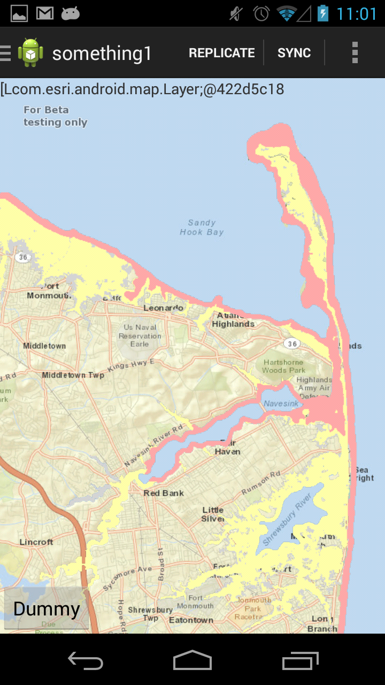
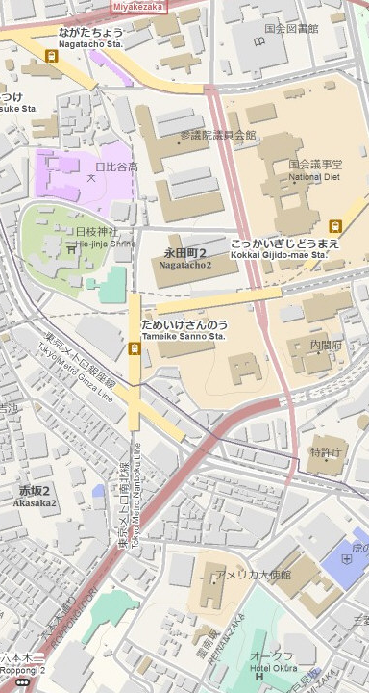
Super Stormer
V
For Support
Doug Carroll
Artemis Fili
John Hauck
Noah Sager
Mohini Todkari
Andrew Wang
Feng Zhang
Notes:
To add your own image:
Delete the image
Click the icon to insert Picture
Adjust cropping if needed to fill the frame with your image (under the Picture Tools contextual menu > Format > Crop)
Voila! A valuable app for the valorous volunteers post a violent disaster. Van guarding aid and vouchsafing the vital supplies to the victims of the vicious calamity. When veterans ventures to survey the vast area for vulnerabilities. The app rids the vexation of verbose paper work and vows velocity for the virtuous volunteers even with the last vestiges of telecommunication. Verily this vichyssoise of verbiage veers most verbose, so let me demonstrate.

Slide 2
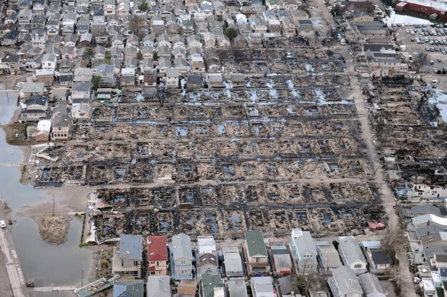
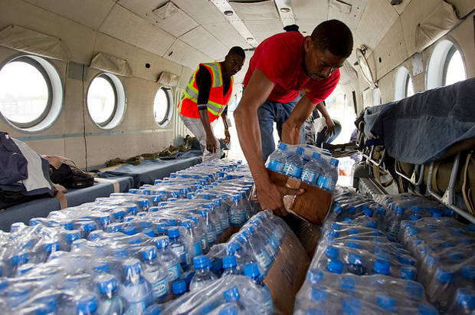
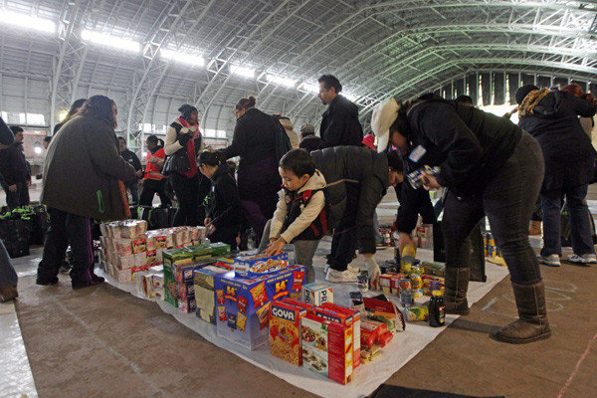
Disaster Relief Organization
Distribute Supplies
Clear Debris
Coordinate volunteers
Identify people who need help
Type of help
Dispatch People

Slide 3





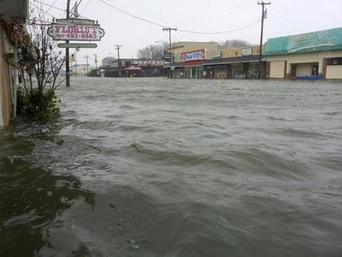
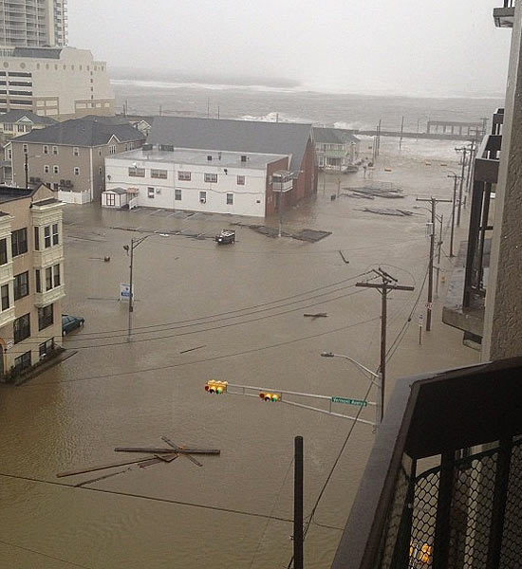
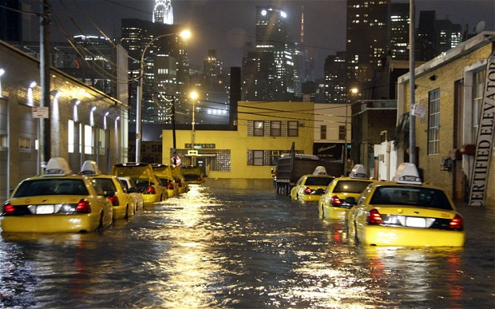
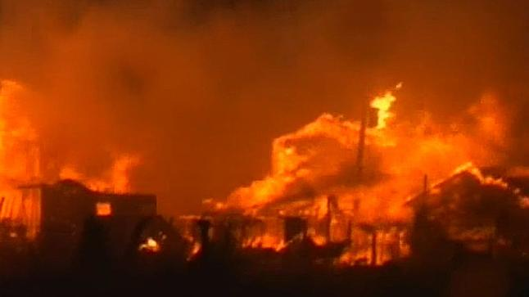
Volunteers: 1. Download App 2. Replicate POIs 3. Edit Offline 4. Sync Offline 5. W2S
DR Center: 1. Publish POIs
2. Dashboard
Notes:
User Screens
Maps have a thin blue border. Use the paint tool to apply this border to your image(s).

Slide 4
Notes:
End your presentation with this logo slide.

